Slide 1
Speech Recognition System
By
Name | ID
Tanvir Ahmed | 2031105642
Shahjalal Hossain | 2021661642
Saleh Sazzad | 2021735642

Slide 2
Introduction
Speech recognition technology is a technology that allows machines to convert voice signals into corresponding text or commands through the process of recognition and understanding.
Speech recognition technology can be used to identify specific person from their speech.
Notes:
Introduce our project after finishing this. We will discuss our project workflow.

Slide 3

How do our system works?
Pre-processing
Feature Extraction
Speech
Prediction
Classification Model
Language model

Slide 4
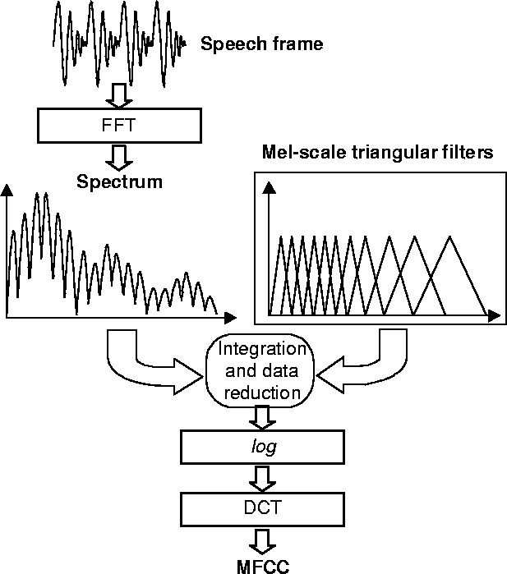
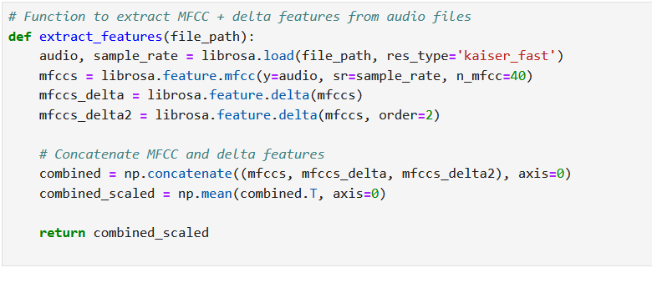
Data Preprocessing
Notes:
DCT = Discrete Cosine Transform MFCC = Mel-Frequency Cepstral Coefficients

Slide 5
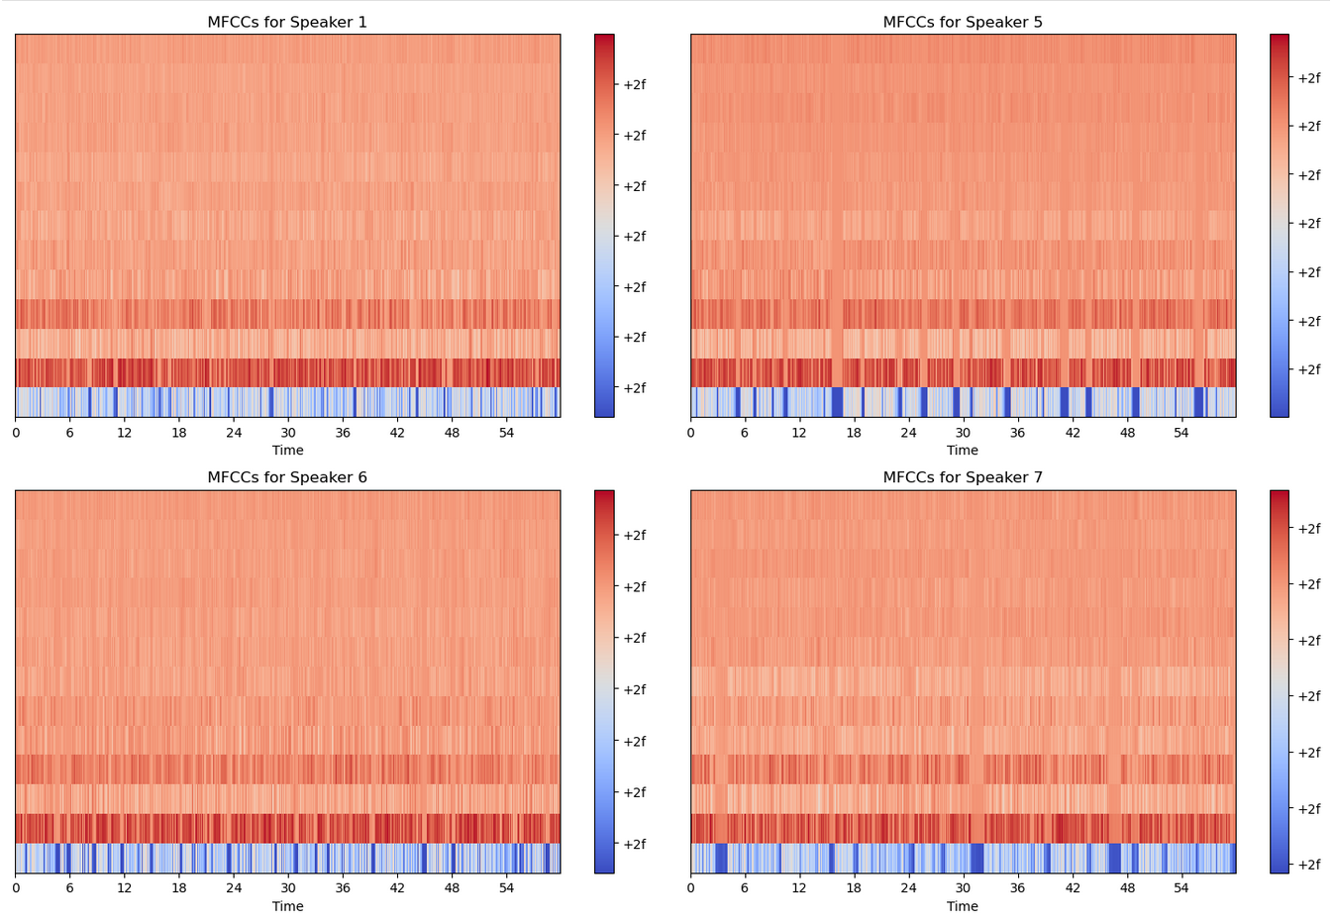

Slide 6
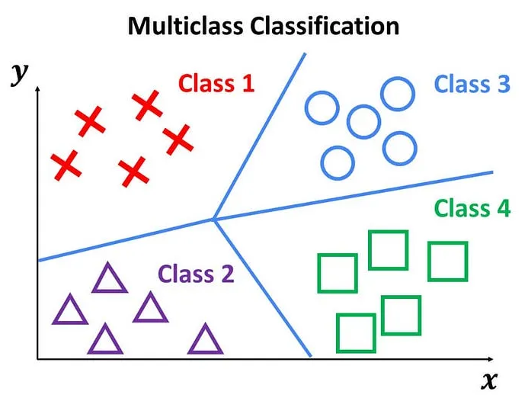
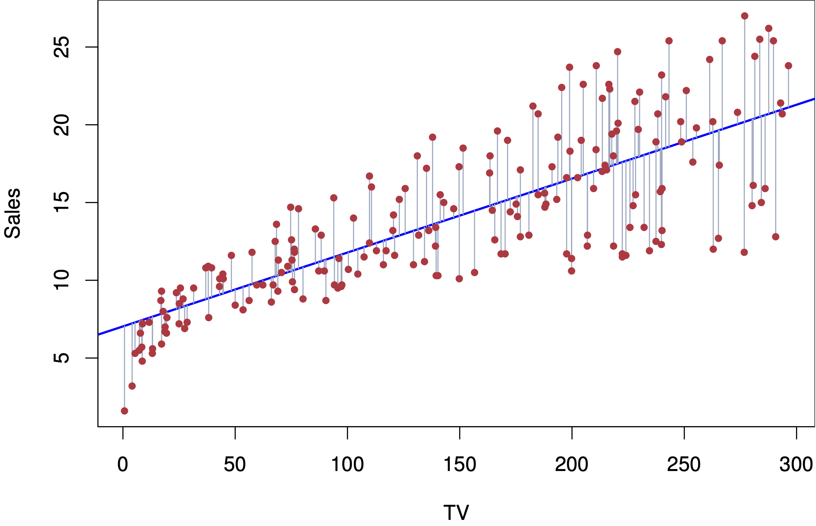
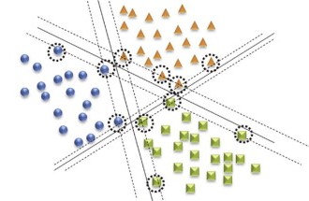
Choosing a model
Linear Regression
Support Vector Machine
Linear regression isn’t suited for classification tasks because it’s designed to predict continuous numerical values, not categories or classes. Using it for classification leads to unreliable and misleading results, as the model struggles to assign clear class labels.
Notes:
We are provided with labeled input data (x features), values to predict (Y variable). So we will not use unsupervised algorithm.

Slide 7
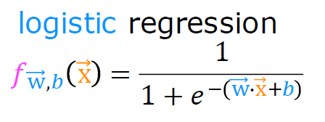
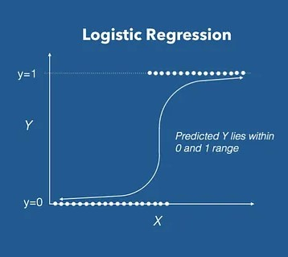
Logistic Regression
What is Logistic Regression?
Logistic regression is a statistical technique used to classify records in a dataset based on input field values, predicting outcomes like customer churn.
It uses independent variables (e.g., age, income) to predict a dependent variable (e.g., whether a customer will leave), distinguishing it from linear regression, which predicts continuous values.
Applications of Logistic Regression:
It can predict various binary outcomes, such as the likelihood of a heart attack, customer purchase behavior, or mortgage default.
Logistic regression not only predicts class membership but also provides the probability of belonging to a specific class.
Notes:
Logistic regression estimates the probability of an event occurring, such as voted or didn’t vote, based on a given data set of independent variables.
Logistic Function – Sigmoid Function
The sigmoid function is a mathematical function used to map the predicted values to probabilities.
It maps any real value into another value within a range of 0 and 1. The value of the logistic regression must be between 0 and 1, which cannot go beyond this limit, so it forms a curve like the “S” form.
The S-form curve is called the Sigmoid function or the logistic function.
In logistic regression, we use the concept of the threshold value, which defines the probability of either 0 or 1. Such as values above the threshold value tends to 1, and a value below the threshold values tends to 0.

Slide 8

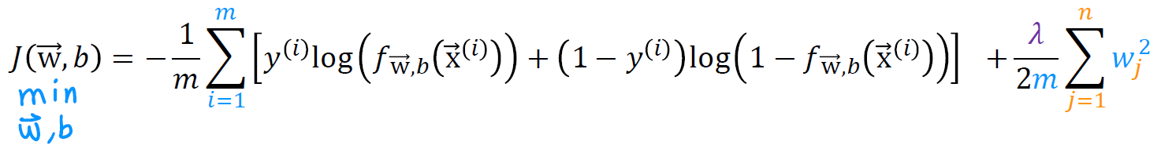
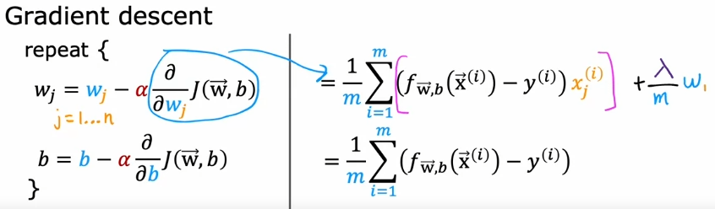

Logistic Regression Training Algorithm
1. Initialize the parameters randomly.
, b
2. Feed the cost function with training set, calculate error.
3. Calculate the gradient of cost function.
4. Update the weights with new values.
5. Go to step 2 until cost is small enough.
6. Predict the speaker

Slide 9
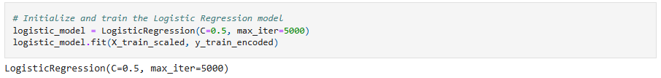
Choosing a model
Why didn’t we choose support vector machine :
Svm is computationally expensive.
Since it’s a large margin classifier, outliers in data can throw off the decision boundary very easily.
The choice of kernel can greatly affect the performance of an SVM, and it can be difficult to determine the best kernel for a given dataset.
SVMs can be sensitive to the choice of parameters, such as the regularization parameter, and it can be difficult to determine the optimal parameter values for a given dataset.
Very complex, hard to understand algorithm.

Slide 10
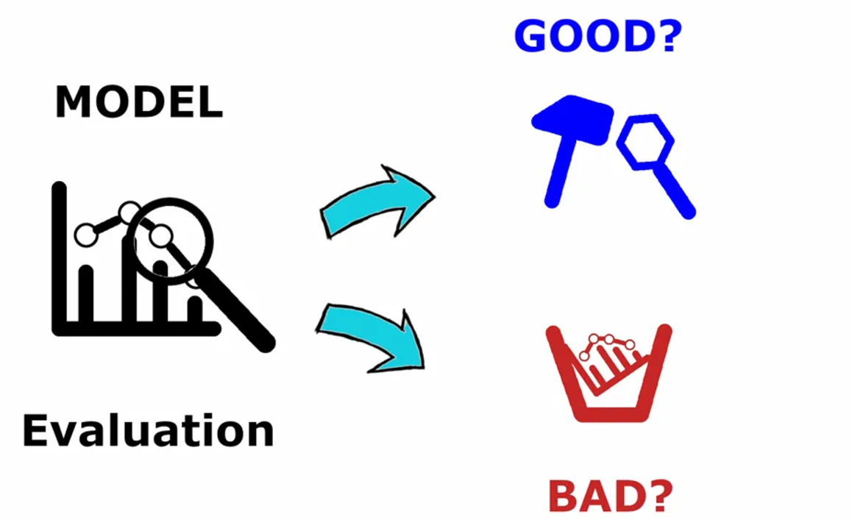
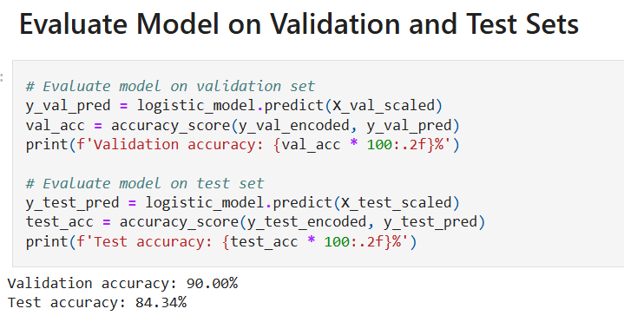
Evaluate the Model
Validation and Test Sets
Validation Accuracy: 90.00%
Test Accuracy: 84.34%
Indicates effective learning and good generalization of the model.

Slide 11
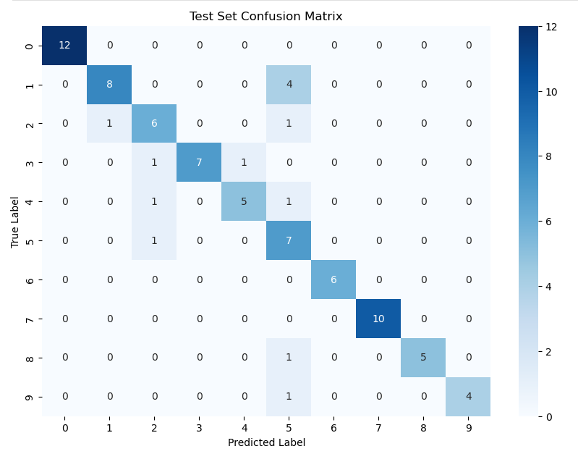
Evaluate the Model
Confusion Matrix
Confusion Matrix Axes:
X-axis: Predicted labels.
Y-axis: True labels.
Key Components:
Diagonal Cells: Correct predictions (true positives).
Off-Diagonal Cells: Very few Misclassifications.
Color Intensity: Areas where the model performs well or poorly.
Darker = Strong Accuracy

Slide 12
Evaluate the Model
Confusion Matrix (Continued)
Performance Highlights:
Strong Classes: Most of the classes showing high accuracy along diagonal.
Error Patterns: Very few Misclassifications(1) in
off-diagonal cells.
Insights:
Model correctly predicts most labels.
Needs optimization for classes with higher confusion.

Slide 13
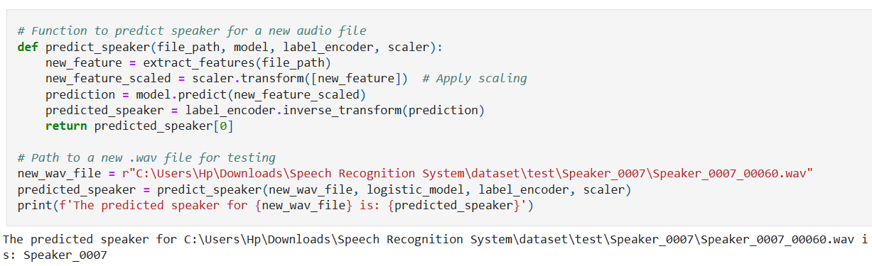
Predict the Speaker
Prediction Output: The model correctly identified the speaker as Speaker_0007(Speaker 7) for the given audio file.
Result Validation: Demonstrates the system's ability to predict speaker identity accurately with new, unseen audio data.
Real-World Uses: Confirms the model's practical usability for speaker recognition tasks.

Slide 14
Future work
1. Enhanced Feature Extraction :Explore advanced audio features, such as spectral contrast and chroma features, to capture more detailed voice characteristics and improve recognition accuracy
2. Model Improvement:
Experiment with advanced machine learning models like Convolutional Neural Networks (CNNs) or Recurrent Neural Networks (RNNs) tailored for audio processing.
3. System Deployment:
Develop a real-time speaker identification application using Streamlit, enabling practical use cases such as authentication systems or personalized AI assistants.

Slide 15
Conclusion
The project demonstrated the use of MFCC and delta features for accurate speech recognition and speaker identification.
By using a logistic regression model, the system achieved significant accuracy in identifying individual speakers.
The project showcases the potential of machine learning to enhance speech-based applications, paving the way for practical and reliable solutions.
The system serves as a strong foundation for further advancements in speech recognition technologies.

